Slide 1
PHA-6020Y
Exam 3 Formative Feedback
Catherine Heywood/Nicky Moore/
Vilius Savickas

Slide 2
REMINDER FROM EXAM SUPPORT WORKSHOP:

Slide 3
Format:
In-person 3 hour exam
Three questions (cases) – covering any of the clinical content taught in semester 1 and 2
No choice – all questions same value
Exam sat in an IT suite (or equivalent) but answers hand-written in separate answers booklets
Open – book …………

Slide 4
Open book
Permitted to access any online resources via the provided computer [except for those that could facilitate communication including OneDrive and other cloud-based storage/file sharing platforms]
Recommended electronic resources to use are:
  BNF (https://bnf.nice.org.uk/)
  Electronic Medicines Compendium (www.medicines.org.uk )
  Medicines Complete (www.medicinescomplete.com)
  National Institute for Health and Care Excellence (https://www.nice.org.uk)
  PHA-6020Y Blackboard

Slide 5
Six (6) sides of hand-written notes:
  Plenty of time, but not enough to look everything up!
  Use them wisely!
  Will be checked by invigilator
  Bullet points for each clinical area:
    What management would you expect to see?
    What pharmaceutical care issues could you get? – review all workshops
    (Textbooks and dictionaries not permitted)

Slide 6
“CRITIQUE”
Detailed analysis and assessment: =>
What is right/correct about the patient’s management and why?
What is wrong/incorrect about the patient’s management and why?
Optimisation: =>
What would you recommend to “optimise” the patient’s management? (“interventions”/”pharmaceutical care issues”)
Parts of questions will guide you!
Marks will be given for correct/appropriate comments even if not in mark scheme!

Slide 7
Normalised Marking Scheme

Slide 8
Question 1:
You are working as a GP pharmacist and have been asked to review AB, 56 year old White Caucasian patient, who was seen in the surgery that morning. Their GP medical notes are as follows:

Slide 9
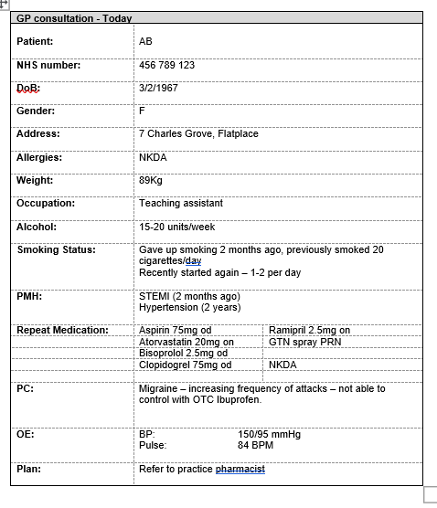

Slide 10
(a) For each of the drugs prescribed for AB (aspirin, atorvastatin, bisoprolol, clopidogrel, ramipril and GTN), provide details of their indication and therapeutic and toxic monitoring parameters. [20%]
Aspirin:
  Indication: 2º prevention of MI
  Therapeutic MP: ↓CV events
  Toxic MP: Signs of bleeding, Hb, S/E:GI
Atorvastatin:
  Indication: 2º prevention of MI
  Therapeutic MP: ↓CV events, Lipid profile
  Toxic MP: LFTs, CK, myopathy
Bisoprolol:
  Indication: 2º prevention of MI, HT
  Therapeutic MP: ↓CV events, BP < 140/90, pulse down to 60bpm
  Toxic MP: BP, pulse
Clopidogrel:
  Indication: 2º prevention of MI
  Therapeutic MP: ↓CV events
  Toxic MP: Signs of bleeding, Hb, S/E:GI

Slide 11
Ramipril:
  Indication: 2º prevention of MI, HT
  Therapeutic MP: ↓CV events, BP < 140/90
  Toxic MP: BP, RF, K+, dry cough
GTN:
  Indication: Ischaemic chest pain
  Therapeutic MP: Chest pain, usage
  Toxic MP: Bp, pulse, flushing/dizziness

Slide 12
(b) With reference to their current repeat prescription, critique the management of secondary prevention of MI in this patient. For any pharmaceutical care issues identified describe the action you would take to resolve these. Include in your answer any monitoring parameters for new medication where appropriate. [25%]
Correct drugs for secondary prevention of MI (NICE) – DAPT* , atorvastatin, ACEI & beta-blocker
(*NICE STEMI => prasugrel first line)
Atorvastatin should be 80mg (secondary prevention) not 20mg (primary prevention)
- Consider PPI e.g. lansoprazole 15mg od for gastric protection as DAPT Monitoring parameters:
  Therapeutic MP: G.I. symptom control, lack of G.I. bleed
  Toxic MP: S/E e.g. diarrhoea, low sodium

Slide 13
Consideration of optimisation(uptitration) of:
  Bisoprolol – uptitrate to 3.75mg od (target 10mg daily - rate control towards 60bpm)
  Ramipril – uptitrate to 5mg daily (target 10mg od)
- Need stop date for DAPT (clopidogrel to stop at 12 months)

Slide 14
(c) Critique the management of hypertension in this patient. For any pharmaceutical care issues identified describe the action you would take to resolve these. Include in your answer any monitoring parameters for new medication where appropriate.[20%]
57-year-old white Caucasian (not diabetic) => NICE advises CCB however ACEI and beta-blocker used for secondary prevention of MI should be used as priority to control BP
BP 150/90 not controlled (target <140/90)
Recommend uptitration of ramipril to 5mg od (target 10mg od for secondary prevention anyway + uptitration of bisoprolol to 3.75mg od)

Slide 15
(d) What lifestyle advice you would offer AB? [10%] )
-smoking cessation
-weight loss
-alcohol – max 14units/week
diet – low saturated fat, low salt, 5/day
exercise – 30mins 5x/week

Slide 16
(e) What advice should be given for the management of their migraines? Explain your answer. [25%]
Record migraine diary
Record/identify triggers /manage
Pain:
  Simple analgesic – soluble works faster, Take as soon as possible an onset of symptoms (at prodrome/aura if possible – before headache)
    Paracetamol 1000mg/aspirin 900mg – not appropriate with 75mg od/ibuprofen 400mg – not working
  Triptan (HT1 receptor agonists) - not appropriate - C/I in CVD (coronary vasoconstriction)

Slide 17
Antiemetic may be helpful (Even in absence of nausea and vomiting)
        E.g. Metoclopramide 10mg tds, Prochlorperazine 10mg tds,
        OTC: Migraleve®, Buccastem M®
Therefore, if migraine not managed with simple analgesia may need to consider preventative therapies:
        Non-selective beta blockers e.g. propranolol - not suitable in addition to existing therapy
        Pizotifen
        Methysergide

Slide 18
Question 2
For each of the drugs prescribed for JT (Oxazepam, lactulose, spironolactone and dalteparin), provide details of their indication and therapeutic and toxic monitoring parameters. [20%]
Oxazepam – Acute alcohol withdrawal
  Therapeutic - Control of the symptoms of alcohol withdrawal, no progression of symptoms
  Toxic - Rebound withdrawal, abuse, drowsiness, RR (respiratory depression), nervous system disorders (light headedness, dizziness), psychiatric disorders
Lactulose – Treatment and prevention of hepatic encephalopathy
  Therapeutic - Stool chart 2-3 soft stools per day, improvement or prevention of the symptoms of hepatic encephalopathy
  Toxic - Stool chart – diarrhoea, adherence, GI disturbance (flatulence, pain, N&V)
Spironolactone - Ascities
  Therapeutic - weight loss [aim 0.5-0.75 kg/day], abdominal girth
  Toxic - U&E’s [RF and K+/Na+], gynaecomastia, s/e – GI disorders
Dalteparin – VTE prophylaxis
  Therapeutic – Lack of VTE
  Toxic – Bleeding and bruising, Hb, PLT, renal function, weight, hyperkalaemia

Slide 19
Critique the patient’s drug history (thiamine, lactulose, spironolactone) in view of her medical history. Explain the rationale behind the use of the prescribed drugs. [30%]
Thiamine 100 mg TDS – Appropriate drug, formulation, dose and frequency of thamine used for the prevention of Wernicke’s encephalopathy in this patient who continues to drink increased quantities of alcohol to reduce the risk of vitamin B deficiency.
Vitamin B is likely to become deficient due to poor oral intake and lowered vitamin absorption due to alcohol consumption as seen in this patient. It can lead to Wernicke (encephalopathy)Korsakoff’s syndrome, an acute neuropsychiatric disorder which can develop into a long term condition.
Patients that continue to drink should remain on this indefinitely, those that become abstinent should continue for a further 6 months – patient still drinking therefore appropriate to continue.
Lactulose 40 mL TDS – Appropriate drug, formulation, dose and frequency for the management of hepatic encephalopathy (provided it is producing the required affect). Patient has severe liver disease (cirrhosis) prior to admission and so is likely to have had hepatic encephalopathy before or is at risk of it.
Hepatic encephalopathy, caused by the excess of ammonia/nitrogenous waste (and other toxic waste products) which are not cleared by the liver due to the cirrhosis, that increase in concentration in the systemic circulation. These can travel to the brain, cross the BBB and cause the symptoms of encephalopathy. Lactulose reduces the gut pH reducing the ammonia producing bacteria of the gut, reduces the absorption of now ionised molecules and increases gut transit to reduce the presence of nitrogenous waste.
Needs to produce 2-3 soft stool a day to be effective at reducing the nitrogenous load of the gut.
Spironolactone 300 mg OD – Appropriate drug, formulation, dose and frequency, and first line pharmacological management of ascites (patient’s examination indicates this). As patients abdomen is distended, the dose may be too low or this may be due to poor adherence – re-start regular dosing and monitor, up titrate to 400mg daily if weight loss not seen.
Liver cirrhosis and disordered liver architecture lead to the formation of collateral circulation and an increase in portal hypertension. Along with a reduction in the production of albumin and activation of the renin-angiotensin/aldesterone system (due to reduced blood flow to the kidneys). This increases fluid reabsorption in the kidney and causes a redistribution of fluid within the abdomen. Aldosterone is also usually broken down in the liver but due to reduced metabolising capacity this is also not possible.
Spironolactone is diuretic treatment to mobilise and remove intra-abdominal fluid and spironolactone is an aldosterone antagonist to reduce its effect.

Slide 20
Critique the patient’s acute management during admission. For any pharmaceutical care issues identified describe the action you would like to take to resolve these. [35%]
Patients MHx (chronic alcohol use and cirrhosis), continued drinking and signs on examination (slurred speech, disorientation, agitation, confusion, shaking, nausea, sweating) – are all symptoms of acute alcohol withdrawal.
CIWA-Ar (Clinical Institute Withdrawal Assessment of Alcohol) – score of more than 10 implies pharmacological treatment is required (withdrawal is present).
SADQ (Severity of Alcohol Dependence Questionnaire) – score of 30 indicates high dependence.
  Pharmacological treatment appropriate
STAT dose of chlordiazepoxide given and oxazepam 20mg PRN prescribed to be administered via CIWA-Ar.
  Management appropriate
Benzodiazepines are required for management of the symptoms of alcohol withdrawal and to prevent progression to more serious symptoms.
An initial dose of chlordiazerpoxide is appropriate prior to initiating the symptom triggered regime. Chlordiazepoxide has a long half-life and is preferred as it may be more effective than short acting ones at preventing seizures and delirium and has less rebound. However, there is a risk of accumulation especially in those with liver disease, like JT - blood tests (reduce albumin, increase PT, generally abnormal LFTs) imply, and diagnosis confirms cirrhosis.
Therefore, oxazepam is an appropriate choice as it has a shorter half-life and less prone to accumulation and toxicity. Close monitoring required due to risk of rebound.
Symptom triggered regime based on CIWA-Ar rather than fixed regime and lowest dose is preferred over fixed regime.

Slide 21
Patient should be on IV pabrinex to prevent/manage (unclear what symptoms the patient has are due to) Wernicke’s encephalopathy. Low threshold for starting. Patient not been taking thiamine Po and poor oral intake. Pabrinex IV high potency (vit B and C injection) – 2 pairs TDS for 3-5 days. Continue with oral thiamine to prevent omission from discharge. Remain on oral thiamine for 3-6 months after cessation of alcohol or indefinitely if still drinking.
Discuss with doctors the need for propranolol to manage portal hypertension. Signs present. Cautious initiation required as extensive first pass metabolism.
Spironolactone missing from chart. Patient should continue to receive this for ascites. Potential for dose increase if 0.5-0.75 kg/day weight loss not seen.
VTE risk assessment not completed, dalteparin prescribed. Ensure risk assessment is completed and risks associated with deranged PT discussed with the medical team.
Phytomenadione to try to manage prolonged PT – 10mg OD IV 3 days. Likely to not be effective as patient has cirrhosis and raised PT unlikely to be due to poor vitamin K absorption, instead due to reduced hepatic production of clotting factors.
Encourage adherence to prescribed medicines. All of DHx appropriate and should be continued.

Slide 22
Prior to discharge, JT suffers a fall spraining her right wrist. Her pain score is 6 at rest and 8 with any attempted movement. Her oxazepam dosing has now stopped. The doctors add the following mediation to her chart:
- Paracetamol 500 mg tablets - 1g QDS
- Morphine sulphate modified release 5 mg tablet - 5mg BD
- Morphine sulphate oral solution 10 mg/5 mL – 1 mL every 4 hours when required
Critique the patients new pain relief. For any pharmaceutical care issues identified describe the action you would like to take to resolve these.
[15%]

Slide 23
Appropriate drug choices for pain relief, however regimes require some reconsideration.
Paracetamol - data is conflicting regarding the safety in liver disease (this patient) and dosing will be guided by local policy, often reducing the dose. Theoretically liver enzyme induction (by chronic alcohol) may enhance the production of toxic metabolites.
Caution is necessary in patients that cannot eliminate the toxic metabolite due to decreased glutathione, i.e. malnourished patients - relevant for this patient.
Also, this patient is under 50kg caution use – reduce dose.
  Reduce the dose to 500mg QDS or TDS or 15 mg/Kg
Morphine – cleared by the liver (extensive first pass metabolism) and a high extraction ratio drug (reliant on blood flow) which will be reduced due to portal hypertension and collateral circulation. Therefore, there is an increased bioavailability, prolongation of duration of action and increased risk of toxicity – relevant for this patient as they have liver cirrhosis.
Morphine is centrally acting and can also induce sedation increasing the risk of encephalopathy.
A common adverse effect is constipation which can increase the risk of hepatic encephalopathy through the build up of nitrogenous waste products.
Modified release makes it difficult to monitor the patients underlying condition and to remove if there is a deterioration in the patient. The half life will be increased even further in this patient with cirrhosis.
Breakthrough pain relief at a 10th of the daily dose – appropriate, however needs to be relative to usual daily dose.
  Recommend removing the MR opioid and using an immediate relief preparation throughout the day, i.e. 2.5-5mg every 4-6 hours PRN.
  Monitor before each dose, only administer if no adverse effects and pain relief required.
  Monitor closely for sedation or deterioration in central adverse effects.
  Review after 24 hours of dosing to estimate 24 hour requirement. A regular immediate release dose may be instated or continue on the PRN regime.

Slide 24
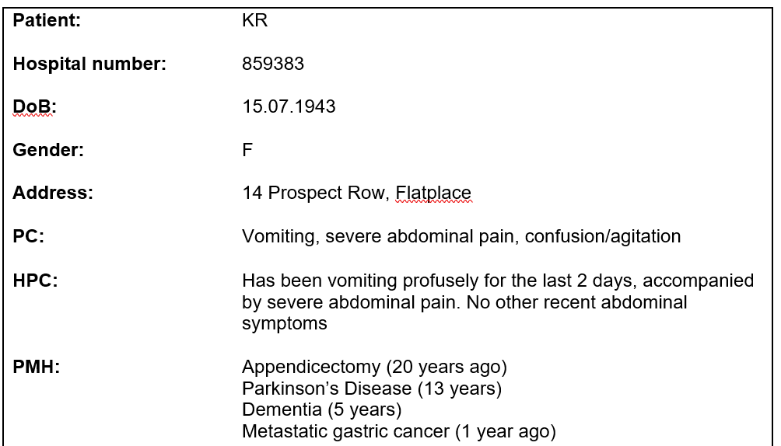
Question 3:
You have a new patient KR, admitted to the surgical ward. Their medical notes and drug details are as follows:

Slide 25
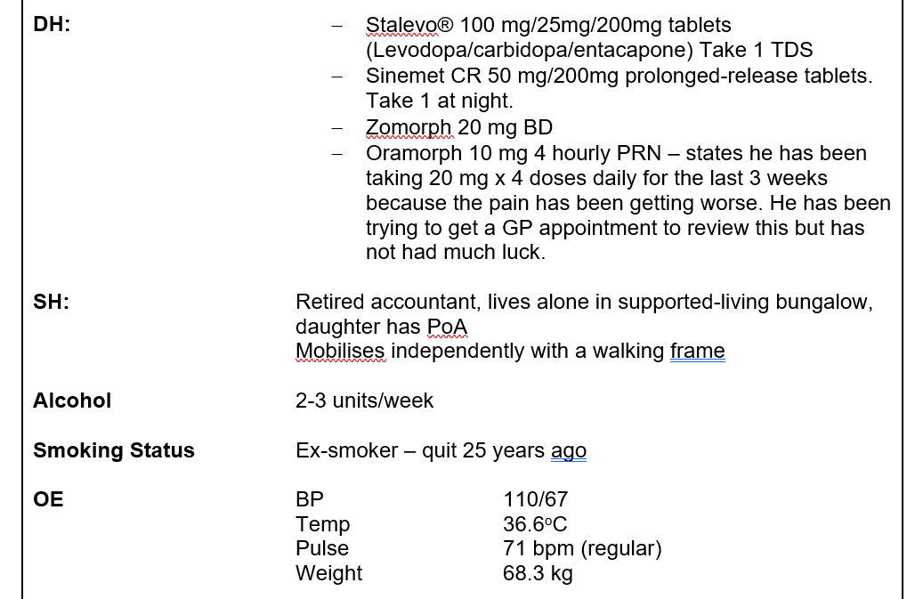

Slide 26
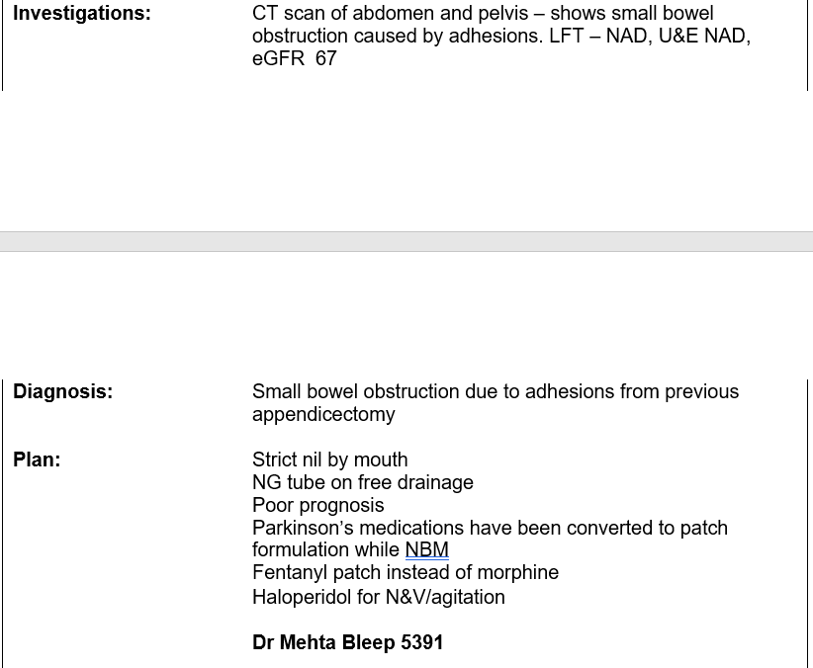

Slide 27
KR has now been prescribed;
· Fentanyl 50 mcg transdermal patch - apply 1 weekly
· Diamorphine 15 – 20 mg subcutaneously 2 hourly PRN for pain
· Haloperidol 2.5 mg 2 hourly subcutaneously PRN for N&V/agitation
· Rotigotine patch 14 mg/24hrs – apply 1 daily
(Their Parkinson’s symptoms are well controlled throughout their admission using the rotigotine 14 mg/24hrs patch)
(a) Using the BNF, critique the newly prescribed analgesia. Include in your answer your pharmaceutical dosage calculations in relation to the conversion from oral morphine to fentanyl patch and the appropriateness of the diamorphine dose for breakthrough pain. For any errors identified make appropriate recommendations to rectify these.
[30%]

Slide 28
  Morphine to fentanyl dose conversion [Up to 15%]
  Confirm patient’s adherence to Zomorph and use of PRN Oramorph prior to conversion to patches to ensure that the dose calculated is appropriate and will not cause toxicity
  Zomorph 20 mg BD = 40 mg
  Oramorph 20 mg QDS = 80 mg
  Total 120 mg daily
  BNF conversion table – 120mg morphine equates to Fentanyl 50 microg/hr patch, which is currently prescribed.
  The BNF however advises that when switching between different opioids, the calculated equivalent dose should be reduced in most cases to prevent patients from receiving too much opioid during this period.
  Guidance from the Royal College of Anaesthetists (UK) suggests that the starting point for dose reduction from the calculated equivalent dose is around 25–50%. Patient factors such as pain severity, age, frailty, tolerability, and current opioid dose are then taken into account.
  Sensible to reduce the dose in this older person to 25 microg/h or 37.5 microg/h patch. Specialist advice may be sought from the acute pain team.
  Fentanyl patches are to be applied every 72 hours, not weekly.

Slide 29
Diamorphine PRN dose calculation [Up to 15%]
Opioid PRN dose = 1/10-1/6 of total daily dose - 12-20mg PO morphine 2 hourly PRN
10 mg PO morphine = 3 mg S/C diamorphine
12-20mg PO morphine = 3.6-6.0mg S/C diamorphine therefore dose should be reduced to 2.5 - 5mg S/C diamorphine every 2 hours PRN (answer or either 2.5mg or 5mg every 2 hours PRN is also acceptable).

Slide 30
b) Explain, using the underpinning science, why haloperidol would be contra-indicated in this patient [30%].

Slide 31
  In PD there is a degeneration of dopaminergic neurons in the nigrostriatal pathway. The nigrostriatal pathway is involved in control of movement. Release of dopamine in the striatum stimulates D1 and D2 receptors which initiate movement via the direct and indirect pathways.
  Loss of these neurons in PD results in the paucity of movement seen in PD patients.
  Haloperidol is a non-selective dopamine antagonist. It would block DA receptors in the striatum, decreasing the dopaminergic transmission that remains, thereby exacerbating the disease. In addition, it would interact with the drugs being used to treat the disease, stopping them from being effective.
  Levodopa is a precursor of dopamine and is converted to DA by the action of dopa decarboxylase.
  Carbidopa is a peripheral dopa decarboxylase inhibitor inhibiting conversion of the levodopa to DA in the periphery.
  Entacapone is a COMT inhibitor which inhibits the breakdown of levodopa DA. All of these therefore increase the amount of DA available at the synapses in the striatum.
  Haloperidol would negate this effect by stopping the DA acting at its receptors.

Slide 32
Despite the poor initial prognosis KR’s bowel obstruction resolves, and she is changed back to an oral regime for all his medications.
Her family have decided that she is no longer able to live independently and have arranged respite care for her with a view to continuing as a permanent resident if she settles into the new care home. The new carers have limited experience supporting patients with Parkinson’s Disease. Meals at the care home are given at 8:00, 12:00, 17:00. They request some written advice for her care plan regarding the management of his Parkinson’s medications.
(c) Compose a written summary for the care home team on how to manage her Parkinson’s medications. Include in your summary information about how the medications work, appropriate suggestion of administration times and instructions, and relevant information about managing side effects.
[40%]

Slide 33
  Answer should include:
  (i) how to administer and appropriate timings
  (ii) how the medication works including limited effectiveness and
  (iii) some appropriate side-effects, avoids use of jargon (without explaining meaning).

Slide 34
  (i) how to administer and appropriate timings
  i. The medication is given orally at the same time every day. Small doses are given frequently to reduce ‘peaks and troughs’ in levodopa levels. Short acting medication and effect may deteriorate toward the end of dose.
  Do not stop the medication unless the prescriber advises. It is potentially dangerous to stop taking it suddenly.
  Should be prescribed by brand so highlight any changes to the pharmacy.
  Any timing allowed within reason provided student gives administration of the medication four times daily (Stalevo TDS and Sinemet CR at night) with an interval of at least 30-60 minutes before and after meals.
  Protein (e.g. meat, fish, eggs, cheese, yoghurt, nuts, beans, pulses) may interact with levodopa. It is therefore generally advised that the medication should be taken at least 30-45 minutes before meals.
  Reinforce the importance of correct timings of administration.
  Seek medical advice if acute illness (e.g. vomiting etc.) prevents oral administration of medications.
  (Up to 15%)

Slide 35
  (ii) how the medication works including limited effectiveness
  Helps improve movement/muscle problems (motor symptoms).
  Sinemet = combination of levodopa and carbidopa. Levodopa replaces the lost dopamine in the brain which is the cause of PD symptoms. Carbidopa is there to improve effectiveness of the levodopa by helping it reach the brain and also reduces side effects.
  Stalevo= combination of levodopa, carbidopa and entacapone. Entacapone slows the clearance of levodopa from the bloodstream.
  Palliative treatment – does not affect disease progression. Effectiveness diminishes with time and doses may be increased with time and/or additional medications added.
  (Up to 15%)

Slide 36
  (iii) some appropriate side-effects, avoids use of jargon (without explaining meaning).
  Side effects - loss of appetite, postural hypotension, vomiting, diarrhoea, bradykinesia (the on-off phenomenon), dizziness, confusions, hallucinations, depression, somnolence, impulsive/compulsive behaviours, dyskinesias (involuntary movements) (any reasonable from SPC, should not be overly alarming).
  Reinforce that medication should NOT be discontinued in event of side effects but continued until these have been discussed with prescriber and/or specialist.
  Any other appropriate counselling points.
  (Up to 10%)

